Slide 1
DRUG RECOMMANDATION SYSTEM
Team 2: Medidi Jayanth Rama Krishna
Konka Rohan
Uzra Furqan
Dara Arjun Kumar
Divya Talakola
Neehan Viren Aiya
Ventatesh Salmeta
Mentor’s name: R P Adhvaith
Natarajan

Slide 2
Business Objective
Use Drug dataset which consists of drug name, condition reviews and ratings from different patients
Our goal is to examine how patients are feeling using the drugs their positive and negative experiences so that we can recommend him a suitable drug.
By analysing the reviews, we can understand the drug effectiveness and its side effects.
In this dataset we can see many patients conditions but we will focus only on the below, classify the below conditions from the patients reviews
a. Depression
b. High Blood Pressure
c. Diabetes, Type 2

Slide 3
Project Overflow
Review Dataset
Exploratory Data Analysis
Data Pre Processing
Train-Test Split
Vectorization
Top 3 Drug Recommendation
Medical condition prediction
Model deployment
Model Building

Slide 4
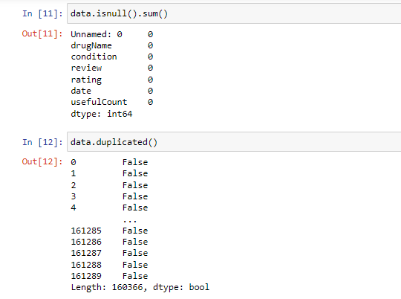
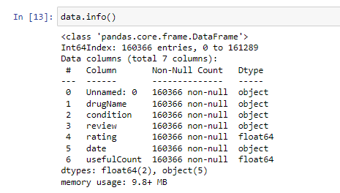
Details of the dataset
We have 160366 rows of dataset with 7 columns or features.
There are no null value and no duplicates in the dataset.

Slide 5
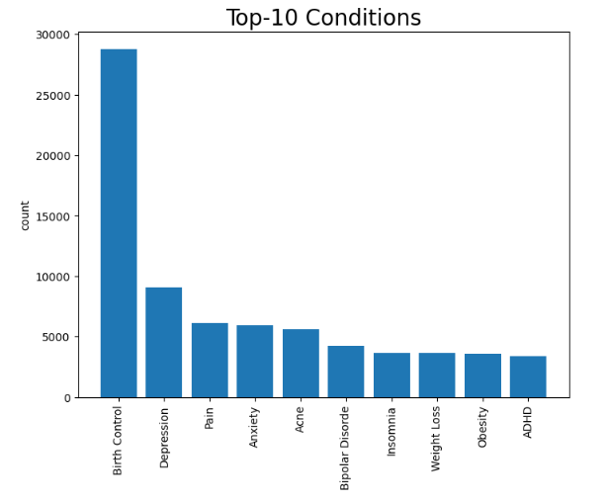
Top 10 Conditions
From above graph we can see that the Birth control is twice as big as anyone, around 28,000.
Most of the conditions for top 10 conditions are having 3000 – 7000 counts.

Slide 6
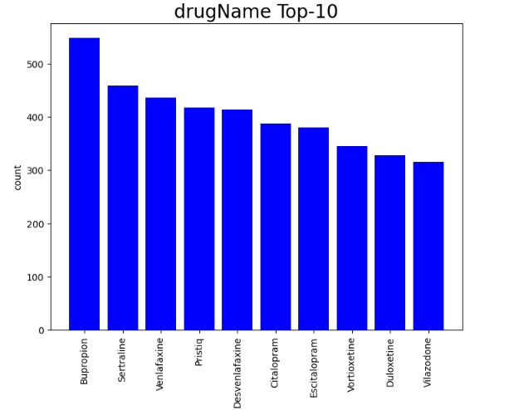
Top 10 drug Name
The top drug Name is Levonorgestrel, which we had seen in description as well.
The top 3 drug Name has count around 2800 and above.
Most of the drug Name counts are around 1000 if we look at top 10

Slide 7
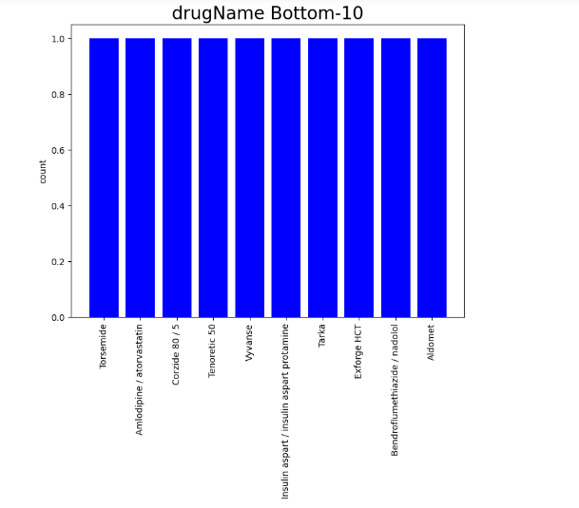
Bottom 10 drug Name
The bottom 10 drug Name has count 1.
These might be the drugs used of rare conditions or are new in market.

Slide 8
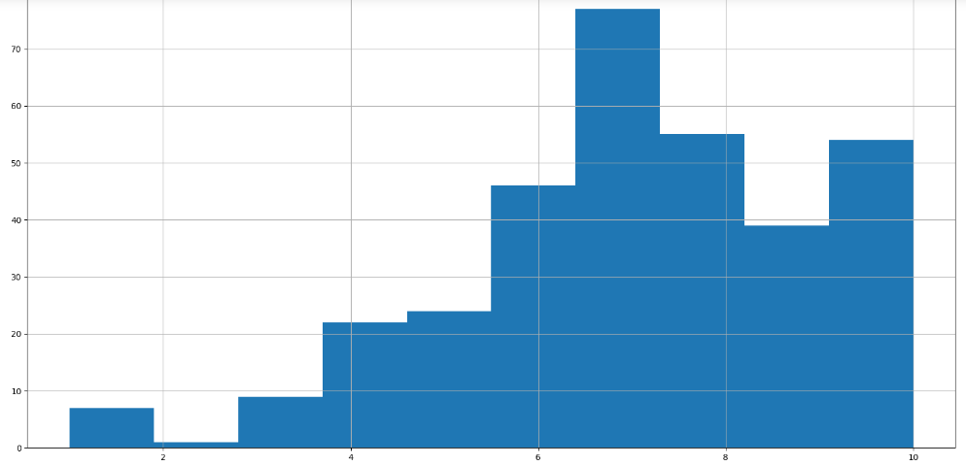
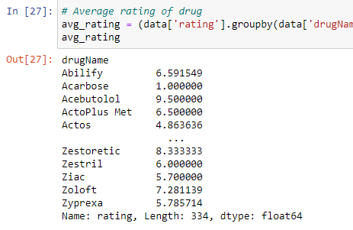
Average Rating of the drug

Slide 9
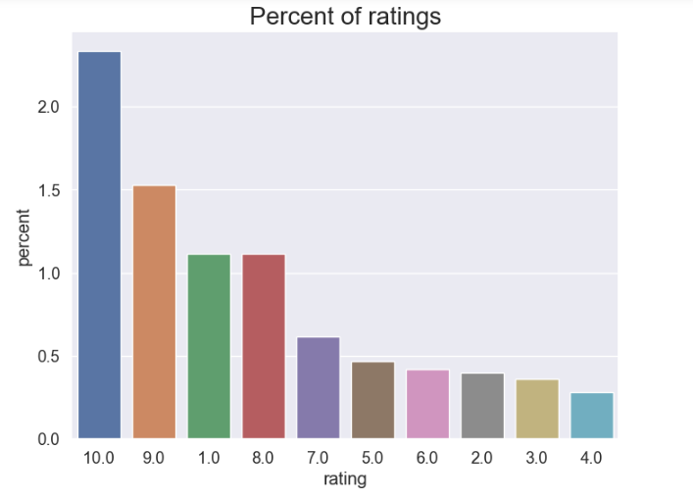
Percent of rating
We notice that most of the ratings are high with ratings 10 and 9.
Rating 1 is also high which shows the extreme ratings of the user.
We can say that the users mostly prefer to rate when the drugs are either very useful to them or the drugs fails, or there is some side effects.
About 80% of the values have rating greater than 5.

Slide 10
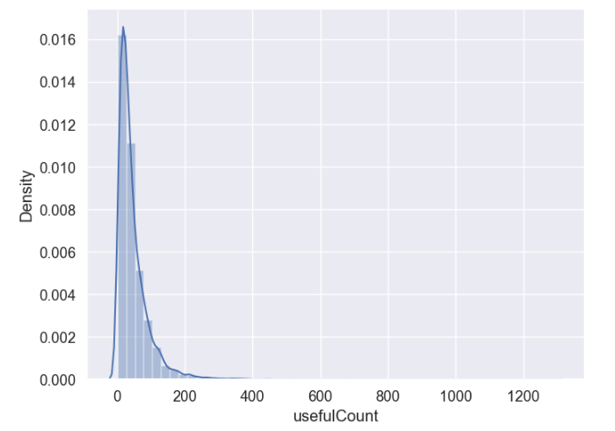
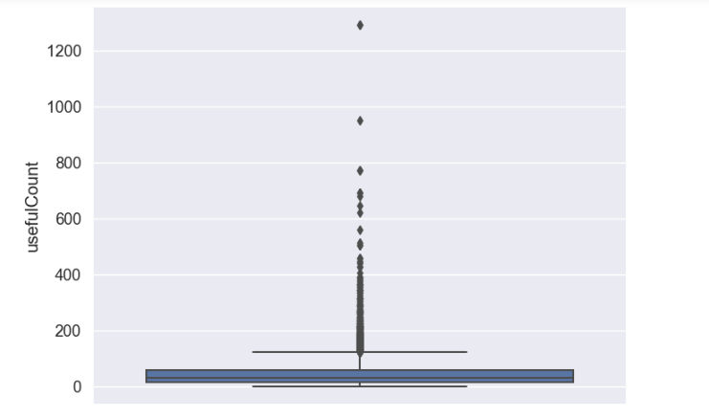
distplot of useful Count
Useful Count is positive-skewed.
Most of the useful Counts are distributed between 0 and 190.
Some drugs have extreme useful counts.
We can see that there are huge outliers present in our dataset.

Slide 11
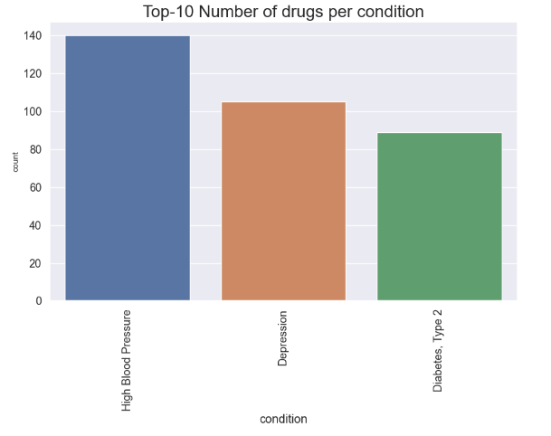
Number of drugs per condition
High Blood Pressure have around 140 conditions.
Depression have around 105 conditions.
Diabetes have around 90 conditions.

Slide 12
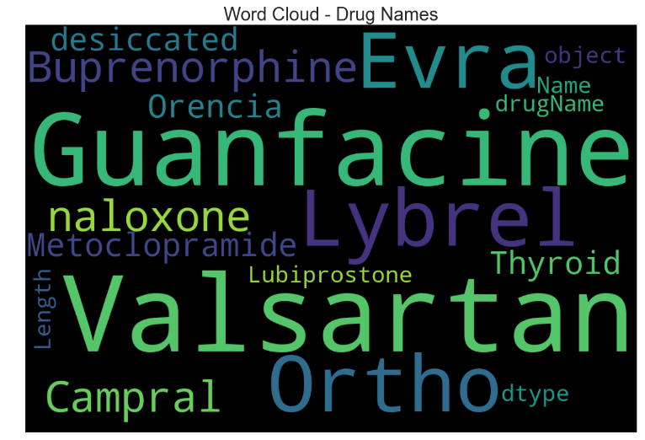
Word Cloud for most popular drugs

Slide 13
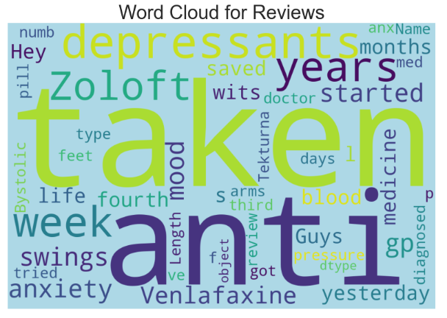
Word Cloud for Reviews

Slide 14
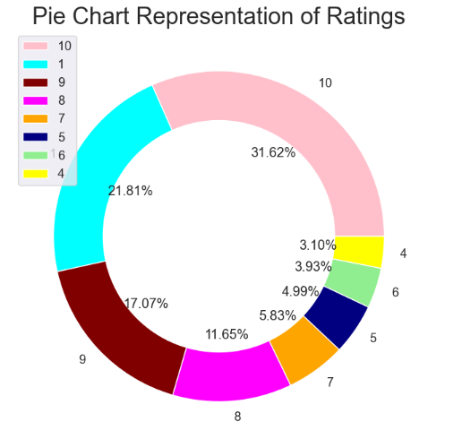
Donut chart to represent share of each ratings
Rating 1 and10 have largest amount of share, which is around 21.82% and 31.62% respectively.
Rating 9 have 17.07 % of the share.
Rating 4,5,6,7 and 8 have lower amount of share.

Slide 15
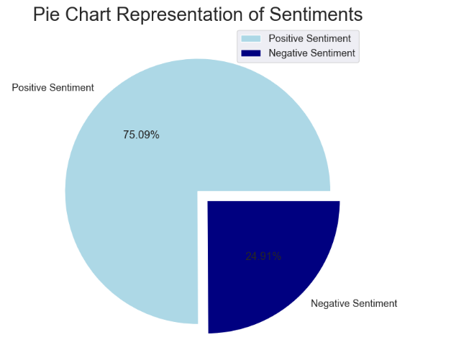
Pie chart to represent the sentiment
There are mostly positive sentiment, which is around 75.09%.
Negative sentiment have only 24.91%.

Slide 16
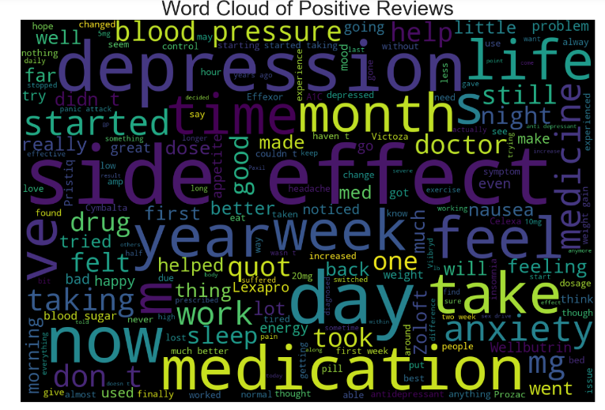
Words cloud for the positive sentiments

Slide 17
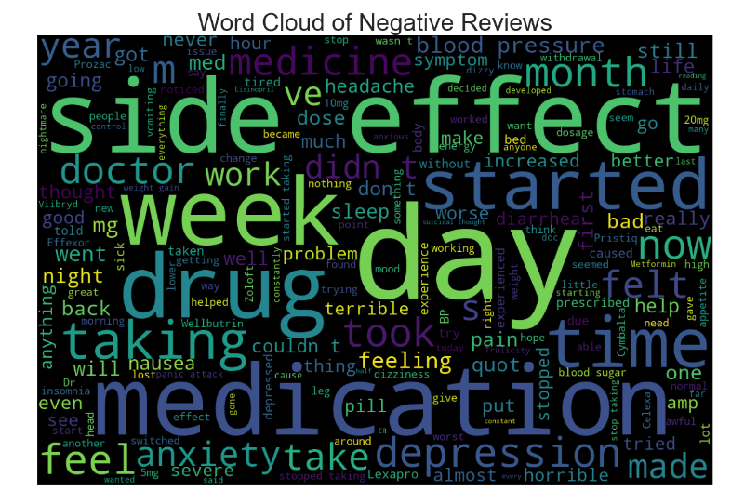
Words cloud for the Negative sentiments

Slide 18
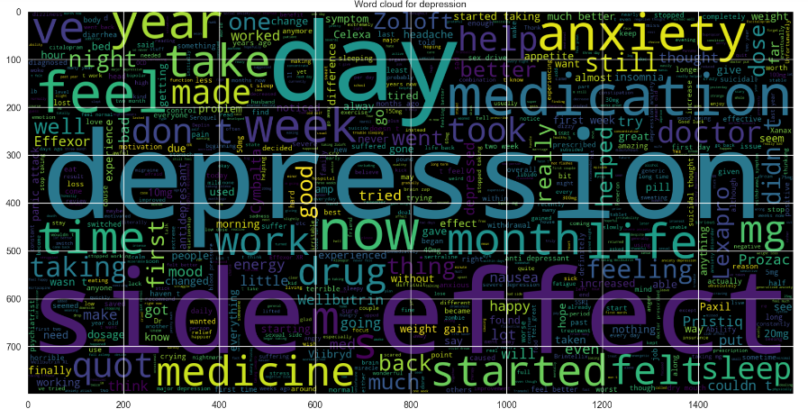
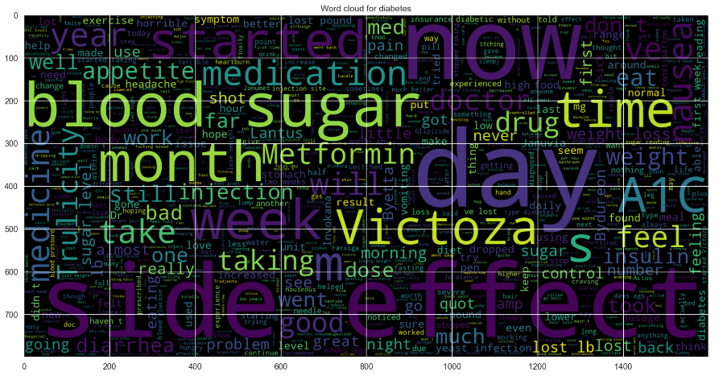
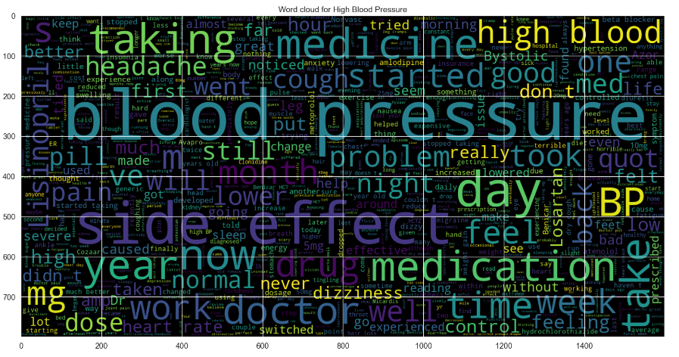
Word clouds for required Conditions

Slide 19
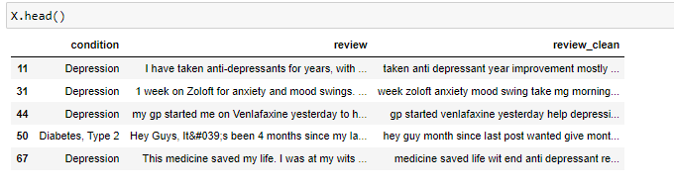
Data Pre-Processing
We have done data preprocessing using BeautifulSoup library and remove the unnecessary words.
After doing lemmatization and stemming we have made one review clean column.

Slide 20
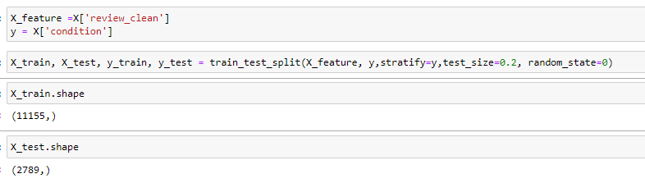
Creating Feature and Target Variable
We have take the review clean as feature variable and conditions as target variable.
Split the data into 80:20 ratio.

Slide 21

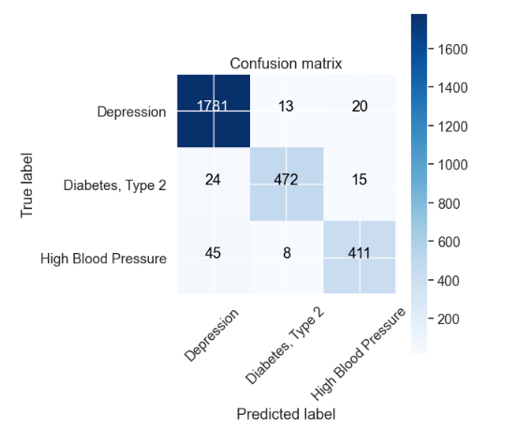
Model Building
Bag of Words Vectorizer: We have made Bag of words vectorizer and generate train and test vectorizer.
Naive Bayes classifier:
We have built naive bayes model, made confusion matrix and got the 95.5% accuracy.

Slide 22
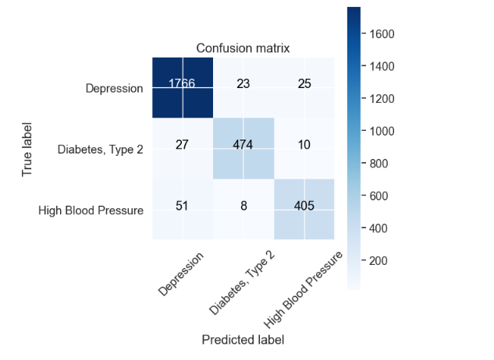
Continue…
Passive Aggressive classifier:
We have built passive aggressive model, made confusion matrix and got the 94.8 % accuracy.

Slide 23
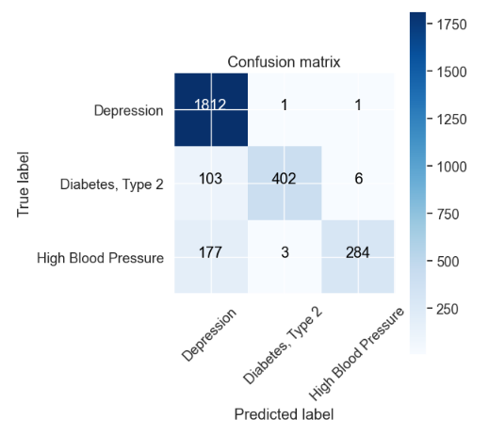

Continue…
TFIDF Vectorizer: We have vectorize the training and testing data using TFIDF vectorize.
Naive Bayes classifier:
We have built naive bayes model, made confusion matrix and got the 89.6% accuracy.

Slide 24
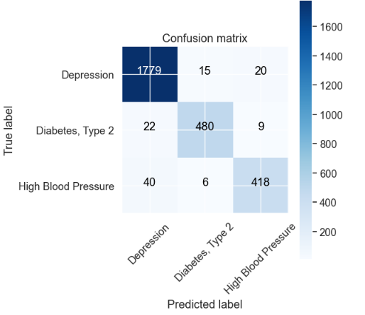
Continue…
Passive Aggressive classifier:
We have built passive aggressive model, made confusion matrix and got the 96% accuracy.

Slide 25
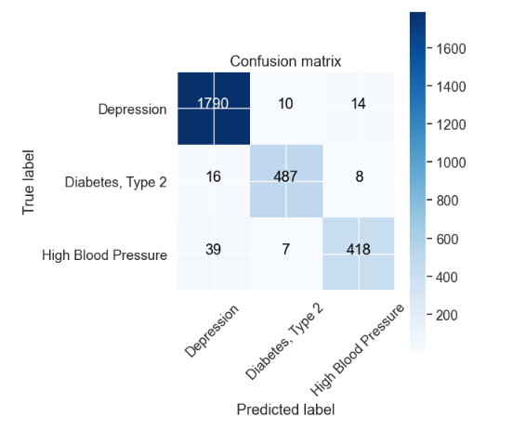
Continue…
TFIDF Bigram:
We have built TFIDF Bigram model, made confusion matrix and got the 96.6% accuracy.

Slide 26
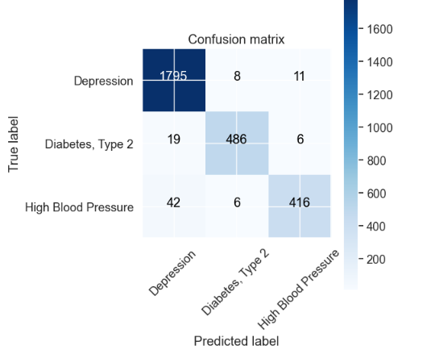
Continue…
TFIDF Trigram:
We have built TFIDF Trigram model, made confusion matrix and got the 96.7% accuracy.

Slide 27
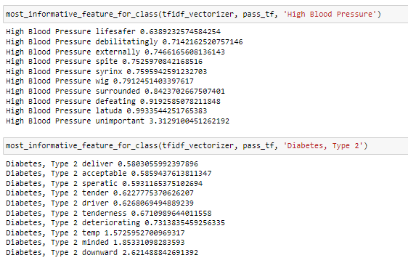
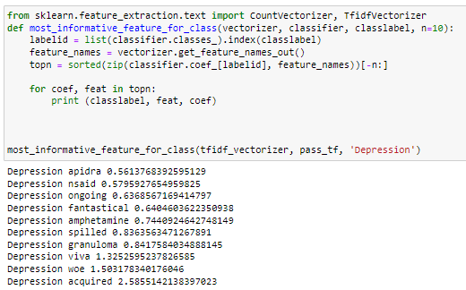
Most Important Feature
We have created a function for 10 most important features for depression, High blood pressure and Diabates-Type2.

Slide 28
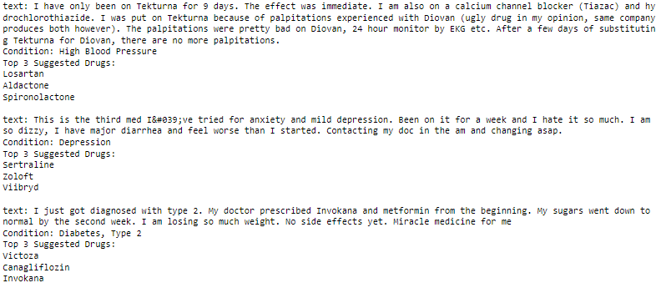
Sample Prediction
We have given three review, based on these review we have got medical condition and prescribed top 3 drug.

Slide 29
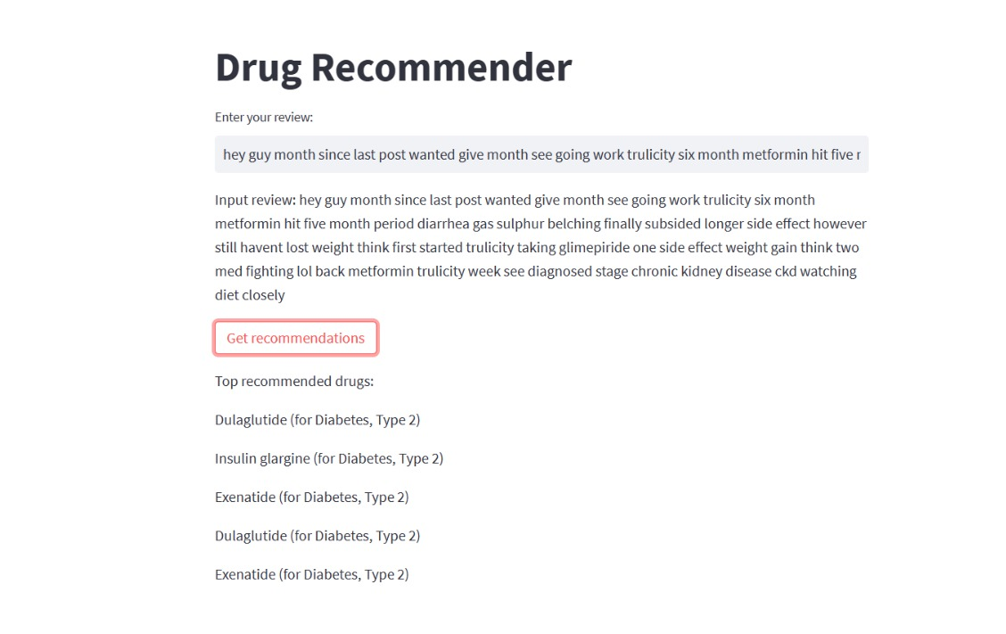
Deployment of the model
we have done the deployment in streamlit, we have a review box to write the review.
After writing the review we can get the top-recommended drugs & condition according to the review.
We have taken three reviews from each condition of depression, high blood pressure & diabetes type 2

Slide 30
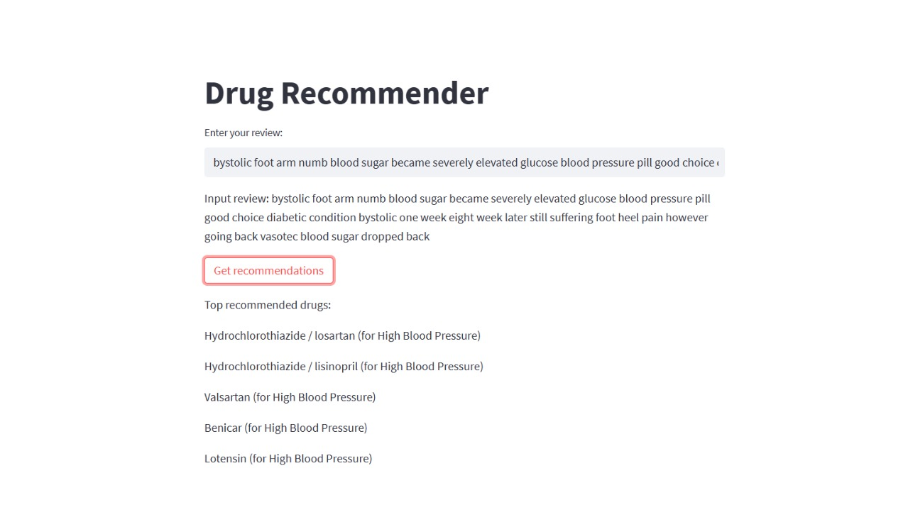
Continue….

Slide 31
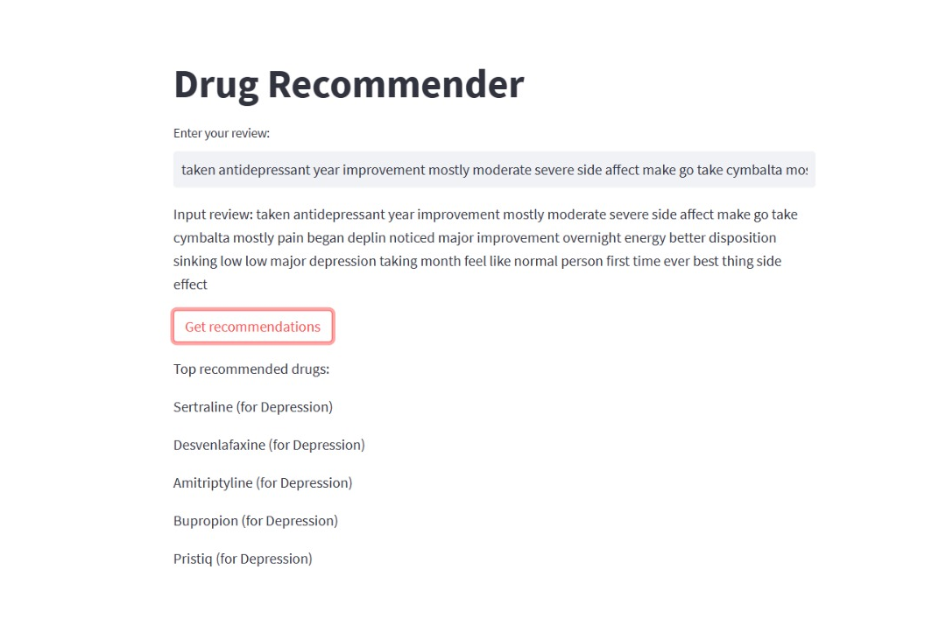
Continue…

Slide 32
THANK YOU

